Slide 1
Pure Release
meister Eckhart’s Way to Unity with God

Slide 2
Release into the God beyond God

Slide 3
Negative Theology & Gelassenheit
Meister Eckhart used negative theology in his sermons
Negative theology recognizes God as MYSTERY, beyond all thinking and all existence
In Sermon 23, Eckhart denies the classic names for God (goodness, being, truth, oneness) and then asks, “But if God is neither goodness nor being nor truth nor one, what then is He? He is pure nothing; he is neither this nor that.”
Eckhart’s understanding of divine mystery affects his understanding of Gelassenheit

Slide 4
Gelassenheit means releasing everything Even God. Insofar as God is a thing, one needs to release God.

Slide 5
Sermon 48: Beyond divine Eigenschaft
Sometimes I have spoken of a light that is uncreated…and that is in the soul…This spark rejects all created things, and wants nothing but its naked God, as he is in himself. It is not content with the Father or the Son or the Holy Spirit, or with the three persons so far as each of them persists in his properties. I say truly that this light is not content with the divine nature’s generative or fruitful qualities. I will say more, surprising though this is. I speak in all truth, truth that is eternal and enduring, that this same light is not content with the simple divine essence in its repose, as it neither gives nor receives; but it wants to know the source of this essence, it wants to go into the simple ground, into the quiet desert, into which distinction never gazed, not the Father, nor the Son, nor the Holy Spirit. In the innermost part, where no one dwells, there is contentment for that light, and there it is more inward than it can be to itself, for this ground is a simple silence, in itself immovable.
God can be a possession, too; even the orthodox understanding of God

Slide 6
Gently release this and this and what remains is nothing but God
Detach from distinction, particularity, from being separate
Detachment means “desiring neither this nor that. It does not wish for anything but to exist. To be either this or that is not its wish. For if anyone wishes to be this or that, he wants to be something, but detachment wishes to be nothing. For this reason it is not a burden to anything.” – on Detachment
When the detached heart has the highest aim, it must be toward the Nothing – On Detachment

Slide 7
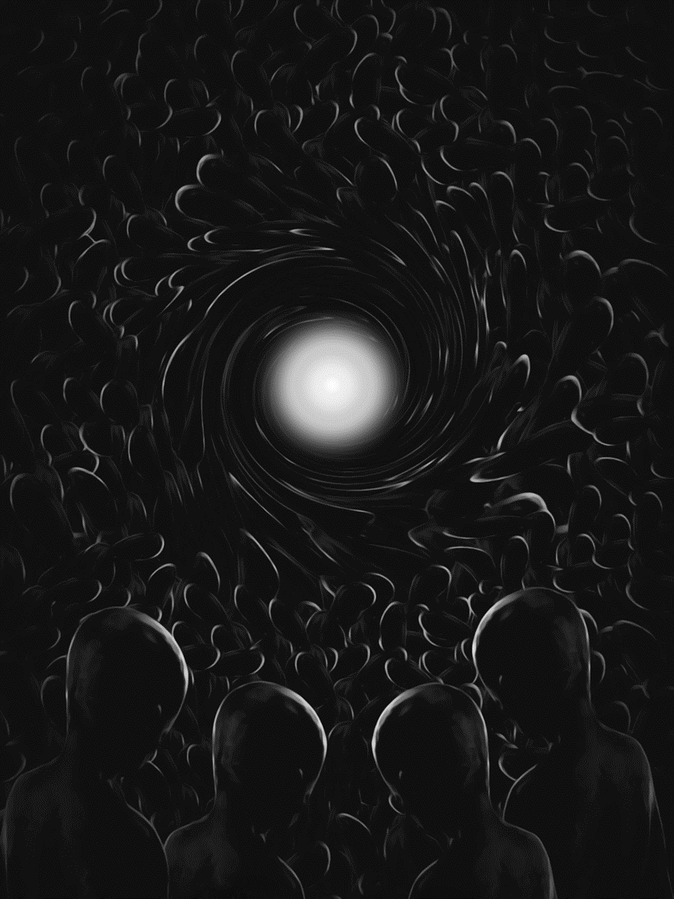
“Paul rose from the ground and with eyes open he saw nothing.” It seems to me that this little word [i.e., nothing] has four meanings. One meaning is: When he got up from the ground, with eyes open he saw nothing, and the nothing was God; for when he saw God, Luke calls this a nothing. The second: When he got up he saw nothing but God. The third: In all things he saw nothing but God. The fourth: When he saw God, he viewed all things as nothing. – Sermon 71

Slide 8
Sermon 71 continued
“Paul rose from the ground and with eyes open he saw nothing.” I cannot see what is one. He saw the nothing which was God.
A person who does not consider all transitory things as trifles and as nothing will not find God.
You must realize that one has to pass over the “little bit” and must remove all additions and know God [as he is] one. Hence the soul says: “When I passed by a little bit, I found whom my soul loves” (S 3:4).
When the soul comes into the One and there enters into a pure rejection of itself, it finds God as in a nothing.

Slide 9
Charlotte Radler
‘To his audience, Eckhart repeatedly underscores that the soul is ontologically rooted in the nothingness of the divine unity and is thus in its deepest essence divine. In fact…the self’s only true existence is the divine nothingness. Eckhart maintains that the human being does not possess a true substantial existence or “I” apart from God. Hence, the “I” or self can never constitute the foundation of reality. Because of the human being’s absolute ontological dependence on God, Eckhart can assert that “where God is, there is the soul, and where the soul is, there is God.” Thus, instead of autonomy and possessive individualism, “theonomy” implies the realization of the human being’s full potential.’
‘Ego-possessiveness includes possessiveness of “God,” since “God” is a projection of ego’s wishes, desires, and needs, and, thus, is an idol. The best way to honor “God” is, thus, to dive into “a-theism” and not to have a “God,” that is, to let God be nothing and exist in the same nothingness.’

Slide 10
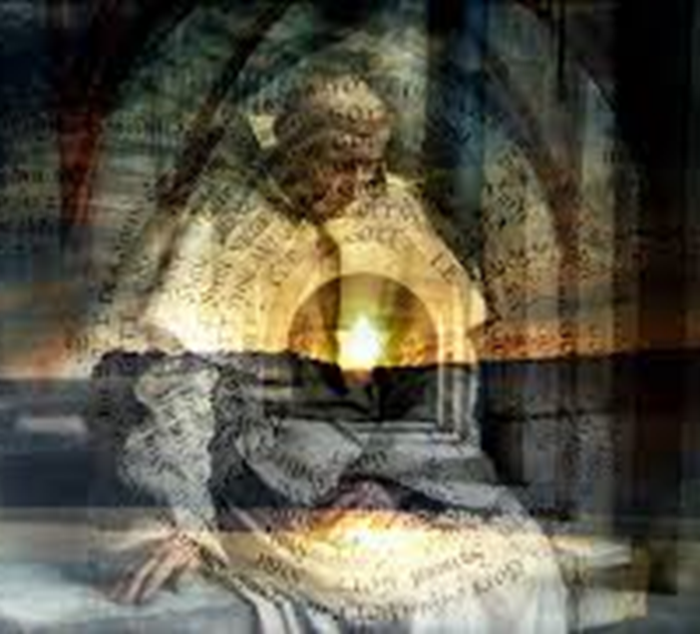
You should love God as he is a non-God, a non-spirit, a non-person, a non-image, but as he is a pure, unmixed bright “One,” separated from all duality; and in that One we should eternally sink down, out of something into nothing.
- Sermon 83

Slide 11
Sinking Into Nothingness
Enter a state of pure nothingness…Become wholly still and detached from all images.
in God there is nothing but God…the “nothing” whose light is all lights, whose being is all beings
Now since something desirable appears in every creature, therefore people love now this and now that. Now put aside 'this' and 'that,' and what remains is nothing but God.
Since it is God’s nature not to be like anyone, we have to come to the state of being nothing in order to enter in to the same nature that He is. So, when I am able to establish myself in Nothing and Nothing in myself, uprooting and casting out what is in me, then I can pass into the naked being of God, which is the naked being of the spirit. All that smacks of likeness must be ousted that I may be transplanted into God and become one with Him: one substance, one being, one nature and the Son of God.
You ought to sink down out of all your your-ness, and flow into his his-ness, and your “yours” and his “his” ought to become one “mine,” so completely that you with him perceive forever his uncreated is-ness, and his nothingness, for which there is no name.
Sink down, out of something into nothing.

Slide 12
Detachment as Releasing Self, God, Distinction
Releasing this and that - identities, attachments, distinctions, time-place – THINKING
“man has to go out of all forms and of himself”
Disappearance of self and disappearance of God
Wholly absorbed in the Godhead, niht – the nothing, “rapt into eternity” and “receptive to nothing but God” but the divine is not an object
“All things become nothing but God for you for in all things you have your eye only on God” — all things become nothing but the nothing
In contemplative silence: nothingness

Slide 13
The state of pure nothingness
From Sermon 103:
“Enter a state of pure nothingness”
“The very best thing you can do is to remain still as long as possible”
“Remain still and do not waiver from this emptiness”
“We should train ourselves to keep God always present in our mind”
-- Stop thinking, enjoy the bliss of the Nothing within.
-- When you start thinking your thoughts, relax into nothing.
-- Disidentify with mental content to identify with absolute nothingness.

Slide 14
In this state of nothingness… of Gelassenheit…
One KNOWS God
…by UNKNOWING
One awakens to God Beyond
…by going within
One realizes the nothing who is all things
…by the silencing of all thinking

Slide 15
In God There Is Nothing but God
In God there is nothing but God,
and when you come to know
all creatures in this nothing,
you come to know the nothing
that is God. So try to know
creatures in the nothing beyond
every something, and there find
this nothing in every something,
which is God. You will either
understand this or you will not.

Slide 16
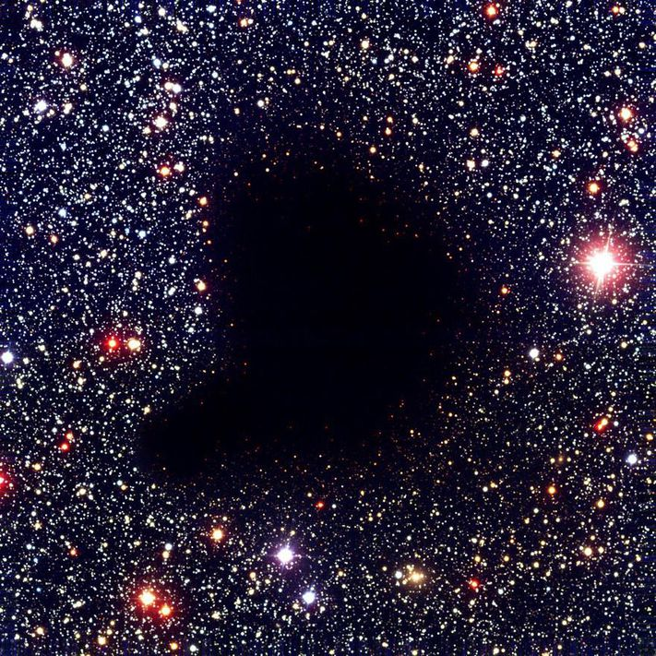
The I is the indistinct nothingness
…realized in contemplative silence
…a silence so absolute that one is knowing nothing, wanting nothing, having nothing, doing nothing, being nothing.

Slide 17
What, then, is Gelassenheit?

Slide 18
The right state of mind…
The state of pure nothingness…
Willing nothing, knowing nothing, having nothing

Slide 19
The single action of the spiritual path is to reduce self to nothingness…
…the nothing whose light is all lights, whose being is all beings

Slide 20
Gelassenheit as Apophatic Practice
Abiding in the state of non-thinking nothingness
A spiritual state in which one does not think but only effortlessly remains nothing or sinks down out of something (thinking, identities, attachments) into the Nothing
In this state, one wants, knows, has nothing
When an attachment “flares up” then one returns to this state and meets the attachment with the nothingness
In this state, the self is reduced to the Nothing that the self always already is but is made to feel unreal by attachment to self and thinking
To center on nothing but God and pay attention to God does not mean thinking about God but resting in nothingness because God is not a thing
To remain in this state is to release oneself into the God beyond God

