Slide 1
Pure Release
meister Eckhart’s Way to Unity with God

Slide 2
Gelassenheit: Releasement or Letting Go

Slide 3
A Released Life
Amidst an anxious time

Slide 4
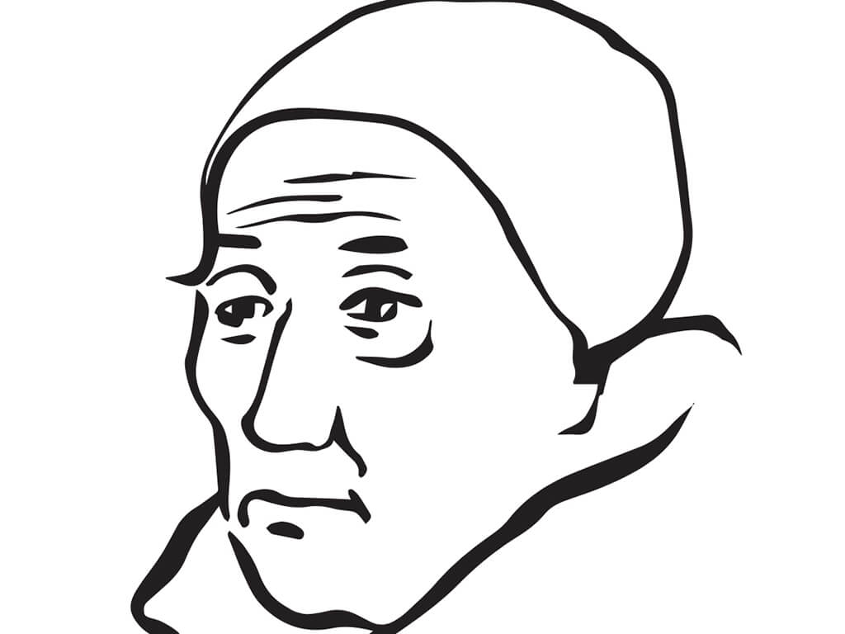

Slide 5
Medieval Germany and Medieval Europe
Who ruled Germany/Holy Roman Empire?
Royal families vied for power, led to numerous battles and bloody contests for the imperial throne – this meant constant small wars
Constant vying for control between different rulers and the Pope
Papacy “captured” by French King and moves to Avignon in 1309
Pope John XXII – money-minded and imperious (and a Franciscan!) – ruled starting in 1316 – previous pope, Boniface ousted Celestine V the pope who retired
Famines and plagues ravished Germany in early 1300s (before the Black Death)

Slide 6
A Chronology of Meister Eckhart’s Life
1260: born in Hochheim
1274-78: Enters Dominican Order at Erfurt (he is about age 18)
1293: Studies in Paris, presumably studied there at some earlier time as well
1294: Eckhart is made prior (leader) of the Dominicans in Erfurt
1302: Eckhart becomes a Master of Theology and assumes a chair in theology at University of Paris
1303-1311: Eckhart is elected provincial of the newly created province of Saxonia
1311-1313: Eckhart takes up the chair in theology for a second time, a very rare achievement
1313-1323: Eckhart moves to Strassburg where he engages in much preaching and teaching, serves as a vicar
1323-1328: Eckhart moves to Cologne, does more preaching
1327: Eckhart gets investigated for heresy, trial moves to papal inquisition at Avignon
1329: Pope John XXII issues bull In Agro Dominico, condemning aspects of Eckhart’s teaching

Slide 7
Major Writings
German Sermons – over 100 spanning his time as provincial (1303-11), in Strassburg (1313-1323) and in Cologne (1323-1328)
  Sermons 101-104 between 1298 and 1305
Talks of Instruction (written between 1295-98)
Book of Divine Consolation (1318)
On the Nobleman (1318)
On Detachment (?)
Latin Sermons (throughout his career, possibly starting in 1290s)
Scripture commentaries: Genesis, Exodus, Sirach (1303-1311), Wisdom, John (1311-1323)
Parisian Questions (1302-1303)

Slide 8
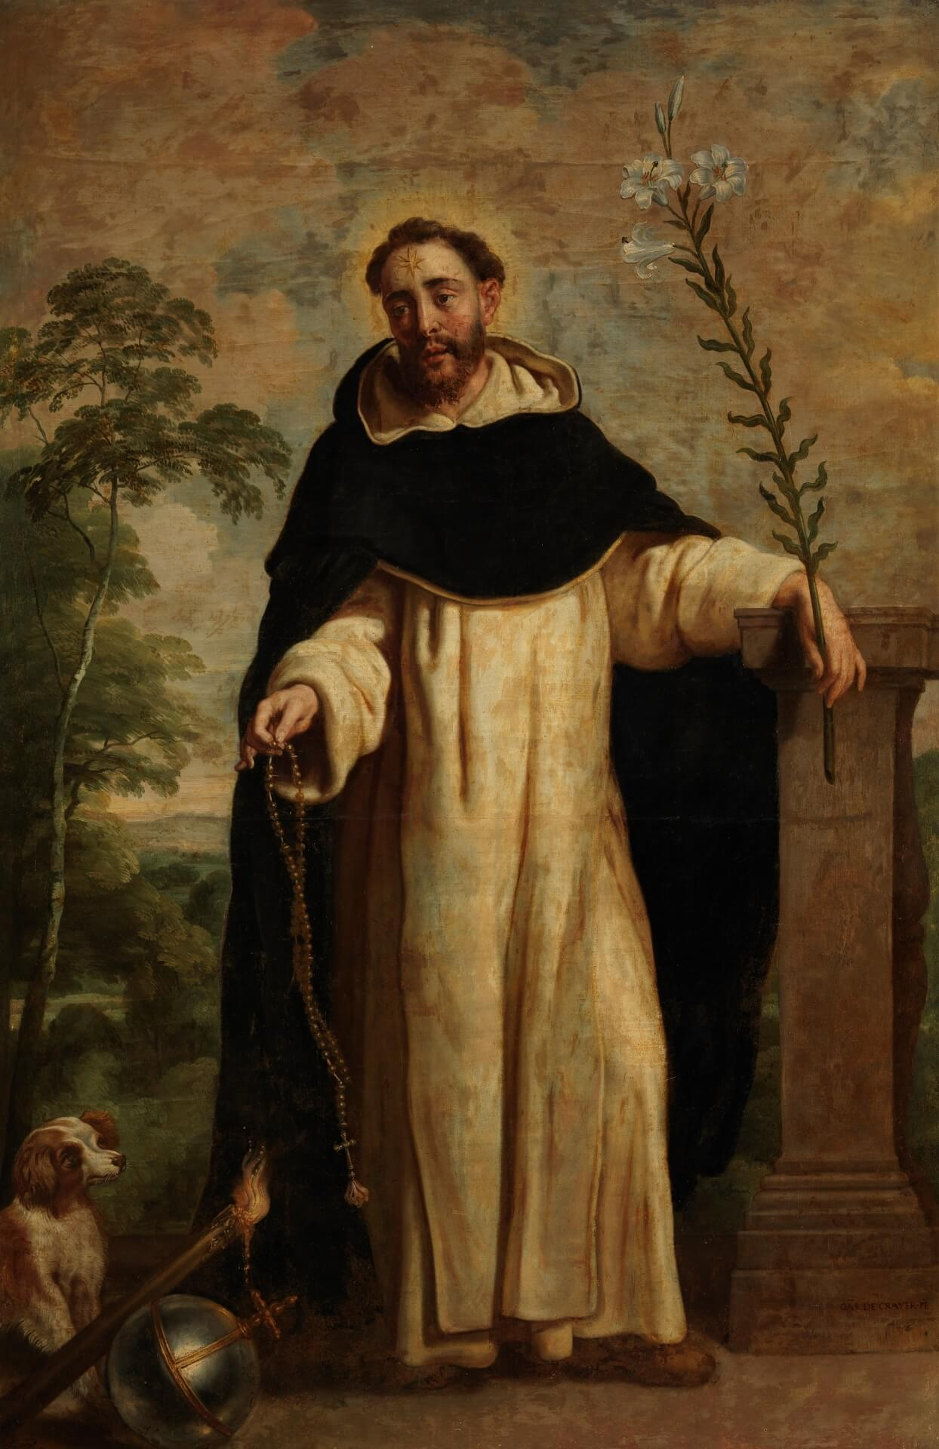
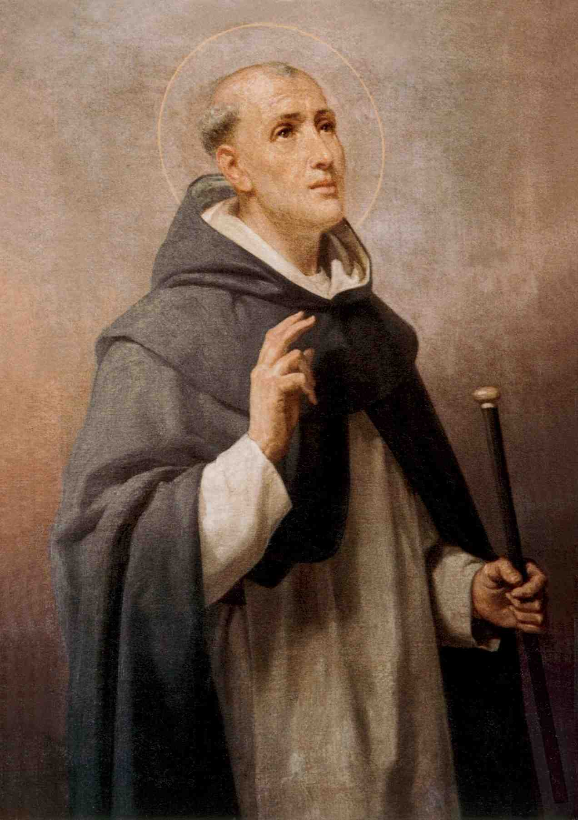
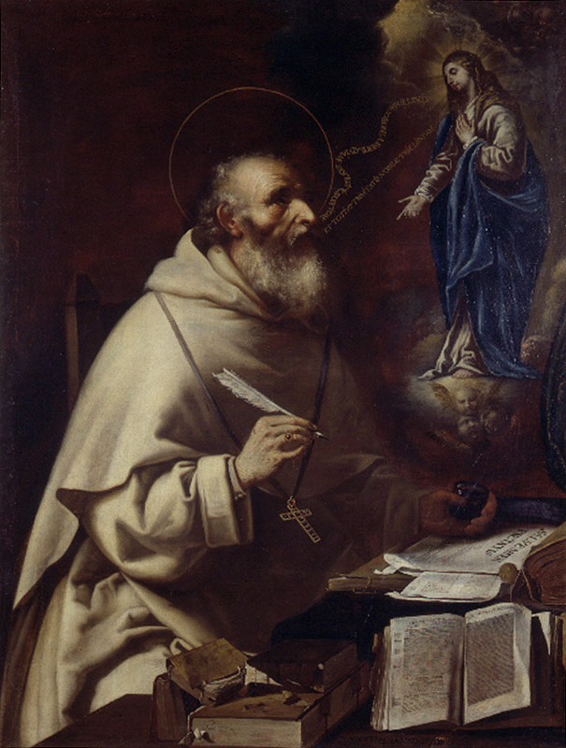
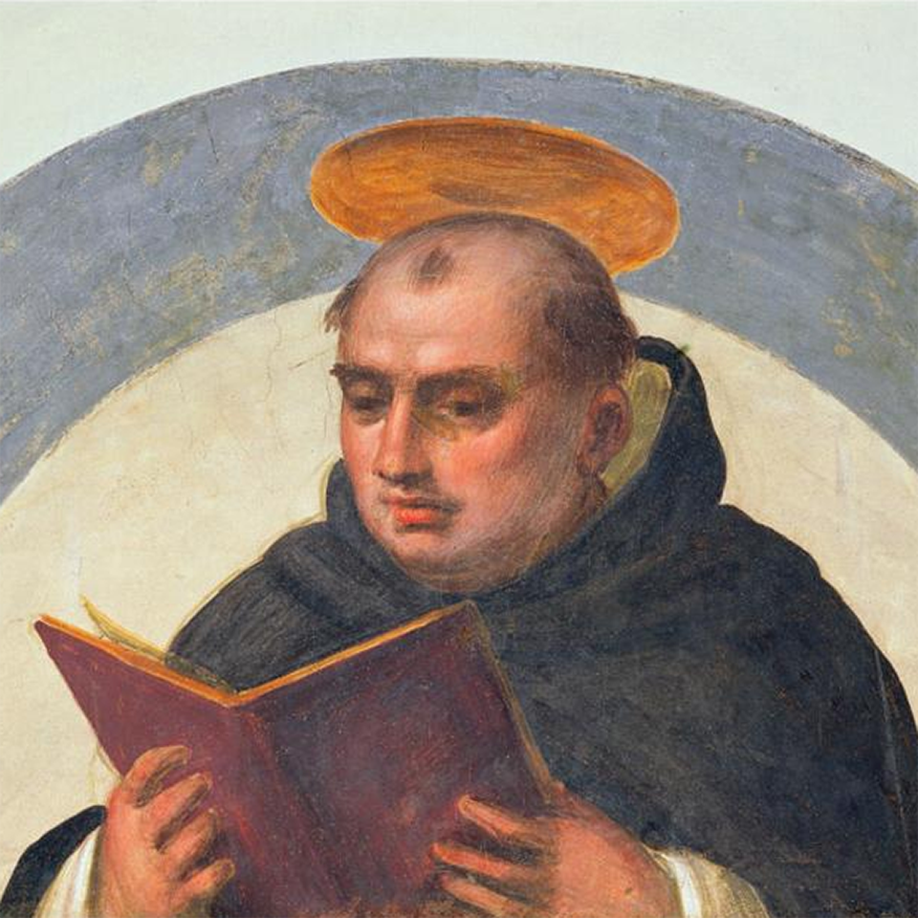
The Dominicans
St Dominic Bl. Jordan of Saxony St. Albert the Great St. Thomas Aquinas

Slide 9
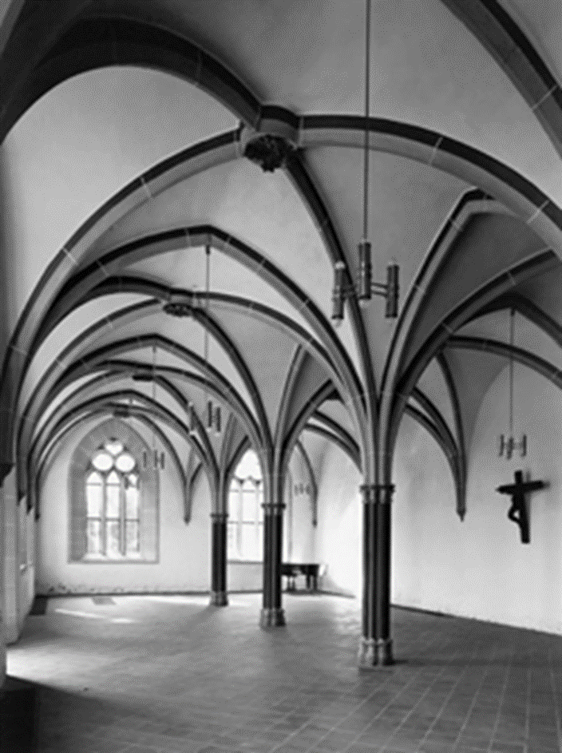
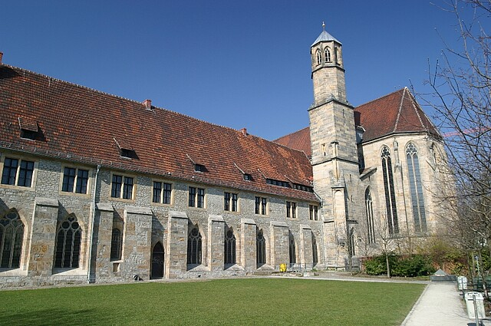
Dominican Life at Erfurt
Divine Office: Matins, Lauds, Vespers
Daily lectures on the Bible
Their lives were suffused with Scripture and prayer
Eckhart was prior here 1294-1302

Slide 10
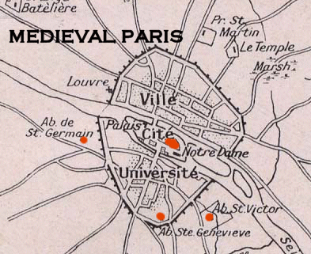
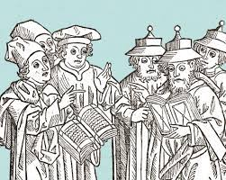
University of Paris – Center of Medieval Learning
Largest and most respected university in Europe
Public disputes were the sport of the day
Thousands attended
The university was on the south side of the city
Eckhart was likely studying here in late 1280s, early 1290s

Slide 11
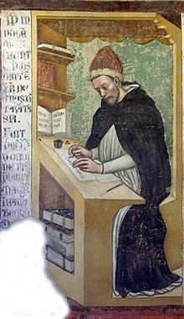
Eckhart the Provincial and Diplomatic Scholar
Elected provincial of a newly created province: Saxonia, which had 100+ Dominican houses
  He visited the priories, reformed them if needed, negotiated with city rulers and secular clergy over these houses
  He appears to have been a very successful diplomat, easing tensions between Dominicans, Franciscans, bishops and secular clergy
  He was the supreme manager of all the properties
There were never any complaints lodged against him during this time (wasn’t punitive)
Eckhart returns to Paris, a rare honor accorded him by Dominican leaders
  Perhaps because the Dominicans were under suspicion after one of their own would not charge the Templars with heresy under the order of the King
  King Philip and the Knights Templar – King destroyed them because he owed them $
Why? He had administrative gifts, yes, But perhaps because he was released

Slide 12
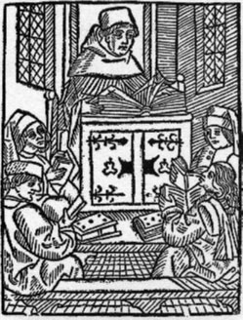
Mystical Preacher
Most of Eckhart’s daring, subversive, paradoxical sermons were delivered in the cities of Strassburg (1313-1323) and Cologne (1323-1328)
he resolved to translate his own innovative religious philosophy into terms that any genuine aspirant, regardless of rank or education, could understand. – Joel Harrington
Ordinary people began to flock to his sermons, delivered in the vernacular rather than Latin, convincing Eckhart that there was a significant popular appetite for sermons of greater spiritual substance. But this very popularity simultaneously exposed him to the wrath of some jealous fellow clerics and the suspicion of certain powerful church leaders who would eventually prosecute him for heresy. – Joel Harrington
Strassburg: bishop and clergy are at odds with Dominicans, Eckhart comes to Strassburg for his diplomatic skills (releasement!) – Dominican leadership believed Eckhart could resolve tensions
Cologne was the largest German city and was ruled by the city council and Archbishop Heinrch Virneburg – an authoritarian church leader who was more politician than pastor for he was a prince and one of the electors of the Holy Roman Emperor – he was also a fanatical heresy hunter because heresy fomented disorder

Slide 13
The Trial of the Meister
His “Defense” shows the Meister practiced what he preached: Gelassenheit
In 1327 Meister Eckhart traveled to Avignon to defend himself against accusations of heresy.
Heinrich of Virneburg accused him. Likely he thought Meister Eckhart to be dangerous because his message became popular.
Before leaving for Avignon, in the Dominican church in Cologne, one of Eckhart’s assistants publicly read a document Eckhart wrote affirming his innocence and willingness to renounce any errors the inquisitors found.
By doing this, Eckhart undercut any charges of heresy. Henceforth, he could only be tried for spreading erroneous teaching.
At the papal court he offered his defense, yet in 1329 Pope John XXII issued the papal bull “In the Field of the Lord.” This bull condemned certain statements of the Meister’s, but they were articles taken out of their original context.
Throughout, Eckhart practiced what he preached. During the trial, he was perfectly willing to give up his life’s work and submit to Church authority. He was not attached to his own spirituality. He did not have a tight mental grip on any of his ideas.
He was quite open to admitting his errors and to renouncing them, considering the Church’s authority to judge orthodoxy. I think this is a great testament to Eckhart’s detachment. As a scholastic theologian and a preacher, words mattered to him. It is all too easy for such a person to identify with these roles and wind up a hypocrite.
We have far too many examples today of people who proclaim their spiritual maturity but in truth lack it. Still, Eckhart shows he is not identified with his own mystical system when he submits to Church authority. Truly, he had let go of himself.

Slide 14
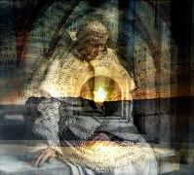
The Inner Life of Meister Eckhart
It seemed to a man as though in a dream—it was a waking dream—that he became pregnant with nothing as a woman does with child, and in this nothing God was born; he was the fruit of the nothing. God was born in the nothing. – Sermon 71
I never pray so well as when I pray for nothing and for nobody. – Sermon 67

Slide 15
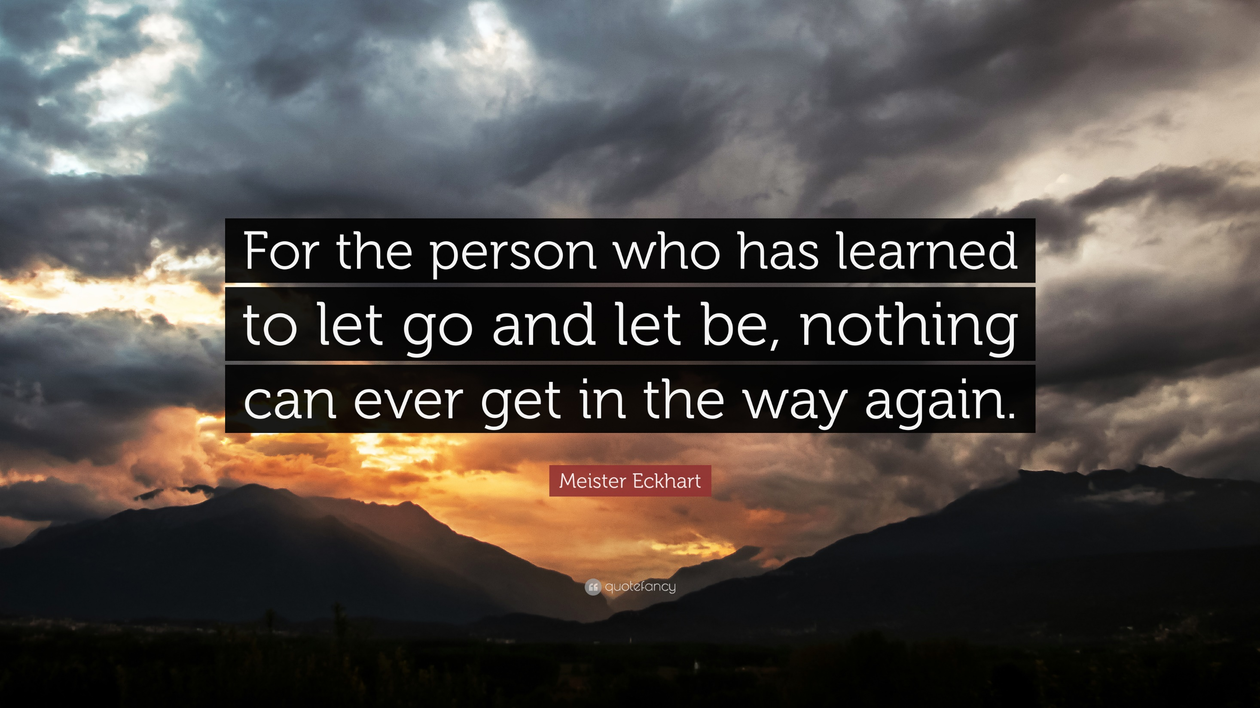

Slide 16
Gelassenheit / Detachment
“Detachment makes me receptive to nothing but God”
“Detachment is completely free from all creatures”
“Put aside this and that and what remains is nothing but God”
This describes Eckhart’s inner life: releasement or letting-go-ness – a gentle practice of sinking into the silent mystery of God as one simultaneously drops attachment to the self.

Slide 17
A poem from the Dominican nuns of the early fourteenth century tells us what Meister Eckhart was known for in his teaching and preaching: “Eckhart, the wise master / Will talk to us about Nothing.” Freimut Loser notes, “True wisdom is teaching about nothing, teaching nothing: to want nothing, to know nothing, to have nothing.” In his own time, then, people remembered Eckhart preaching about nothing. Loser’s comment alludes to one of Eckhart’s most common themes, detachment. In many of his sermons, he describes the way and practice of detachment by using the word, “nothing.” But Eckhart loads other weighty meanings onto this word.

Slide 18
Eckhart’s Theme and Various Images
The Meister has one simple message strewn across his sermons, talks, commentaries, and treatises: Realizing the Nothing by Gelassenheit – birthing, negative theology, detachment
“Deny yourself, take up your cross…lose your life.” – Mark 8:34-35
More than a message, it is his mystical goal in preaching and teaching, namely, to usher others into the ego-devastating and world-shattering realization of the divine nothing by means of releasement, gentle and relaxed letting go and letting be.
Eckhart reflects on and teases out different subtle aspects of this message and experience.
So, it is difficult, if not impossible, to systematize Eckhart – some words, for instance, mean different things at different times – even in the same sermon
He will use “intellect,” “nothing,” “birth,” “being,” or “breakthrough” in several senses
His themes cannot be separated; they are indistinctly one, a diamond reflecting light from a unique angle

