Slide 1
Pure Release
meister Eckhart’s Way to Unity with God

Slide 2
Gelassenheit
Releasement
Letting-go-ness
Letting-be-ness

Slide 3
Releasing the Self

Slide 4
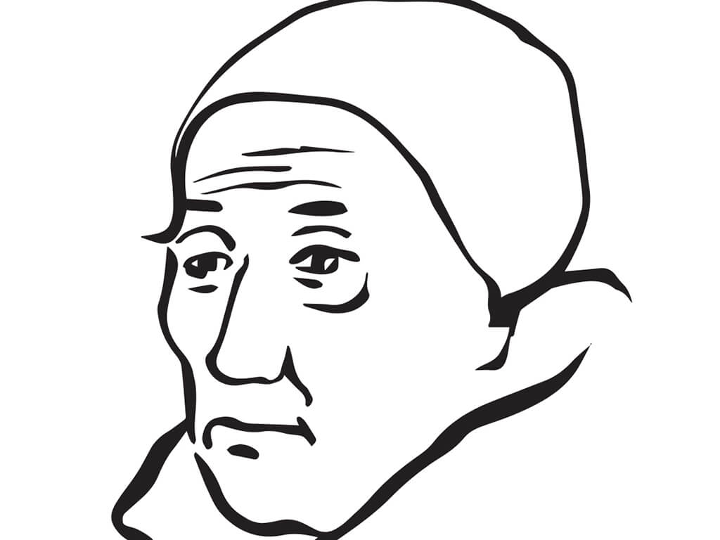
The Way of the Meister:
Gelassenheit
Typical medieval sermons:
  Sin
  Guilt / Penance
  Go to confession
  Perhaps inspire with a saint story
Eckhart’s preaching:
  Realize the Nothing by Releasement
  “all our perfection and all our bliss depends on our traversing and transcending all creatureliness, all being and getting into the ground that is groundless” – Sermon 42

Slide 5
Eckhart Preaches to all
Do not be afraid, for this joy is close to you and is in you: there is not one of you who is so coarse-grained, so feeble of understanding, or so remote but he may find this joy within himself, in truth, as it is, with joy and understanding, before you leave this church today, indeed before I have finished preaching: he can find this as truly within him, live and possess it. – Sermon 66
The Meister did not restrict his way to monks, nuns, or only people who have extraordinary religious experiences such as visions
His way of letting go into the Nothing is for everyone

Slide 6
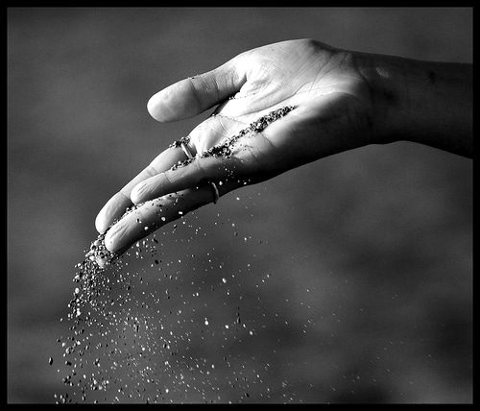
Gelassenheit
Gentle dropping
Effortless releasing
Sinking into nothing
To gently release the “this and that” of creation to sink into the divine nothing is true repentance
But…Releasing what? What does one let go of?

Slide 7
Table Talk 3
People say: “O Lord, how much I wish that I stood as well with God, that I had as much devotion and peace in God as others have, I wish that it were so with me!” Or, “I should like to be poor,” or else, “Things will never go right for me till I am in this place or that, or till I act one way or another. I must go and live in a strange land, or in a hermitage, or in a cloister.”
In fact, this is all about yourself, and nothing else at all. This is just self-will, only you do not know it or it does not seem so to you. There is never any trouble that starts in you that does not come from your own will, whether people see this or not. We can think what we like, that a person ought to shun one thing or pursue another—places and people and ways of life and environments and undertakings—that is not the trouble, such ways of life or such matters are not what impedes you. It is what you are in these things that causes the trouble, because in them you do not govern yourself as you should.
Therefore, make a start with yourself, and abandon yourself. Truly, if you do not begin by getting away from yourself, wherever you run to, you will find obstacles and trouble wherever it may be.
Self (ego)
is the primary attachment.

Slide 8
Sermon 2
The Meister gives us a word describing attachment: possessiveness or eigenschaft – first, to be free of images
“This little town is so truly one and simple, and this simple one is so exalted above every manner and every power, that no power, no manner, not God himself may look at it. It is as true that this is true and that I speak truly as that God is alive! God himself never for an instant looks into it, never yet did he look on it, so far as he possesses himself in the manner and according to the properties of his Persons. It is well to observe this, because this simple one is without manner and without properties. And therefore, if God were ever to look upon it, that must cost him all his divine names and the properties of his Persons; that he must wholly forsake, if he is ever once to look into it. But as he is simply one, without any manner or properties, he is not Father or Son or Holy Spirit, and yet he is a something that is neither this nor that.”
Frank Tobin:
“Every name is an eigenschaft in that it limits what is described and binds it.”
“Even the Persons of the Trinity must divest themselves of this last eigenschaft of being separate persons before God can look into the temple of the soul.”
“The underlying unity of the sermon becomes apparent only when one realizes that eigenschaft, applied here to God at the close of the sermon, expresses the same content as when it is used in regard to the human soul in the first part of the sermon. Eckhart’s linguistic achievement is precisely that with a single word he is able to span religious thought from common asceticism to the heights of mysticism, while at the same time and with the same word joining God and the human soul by means of an attribute necessary to both for their union.”

Slide 9
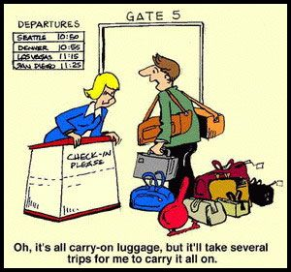
The Meanings of Eigenschaft
Property – ownership, some person, thing, experience I claim as my own
Possessiveness – bondage to an attachment, to what I demand in order to be happy
Particularity – distinction, characteristics, limits
“‘Eigenschaft’ (property) is self-reference.” – Kurt Flasch

Slide 10
Aspects of the attachment to self
Eigenschaft takes different forms.
  Multiplicity, corporeality, and temporality
  Images, forms, thoughts
  Spiritual things
  God
Eigneschaft leads to suffering and the merchant mind

Slide 11
From The Book of Divine Consolation
All suffering comes from attachment.
if I suffer on account of transitory things, my heart still has attachment to and affection for transitory things, so that I do not love God with all my heart nor that which God wants me to love together with himself.
We can ascertain if we are in the right spiritual state by whether we would have bliss and joy in abandoning and taking leave of our own natural will and in going out of ourselves entirely in all those things which God wills us to endure.
Therefore our Lord says: ‘Blessed are the poor in spirit’ (Matt. 5:3). They are poor who have nothing. ‘Poor in spirit’ means this: just as the eye is poor and bereft of colour, and is thus receptive to all colours, so too those who are poor in spirit are receptive to all spirit, and the spirit of all spirits is God. Love, joy and peace are the fruits of the spirit. Possessing nothing, being naked, poor and empty, transforms nature. Emptiness draws water uphill and causes many other miracles of which we cannot speak here.

Slide 12
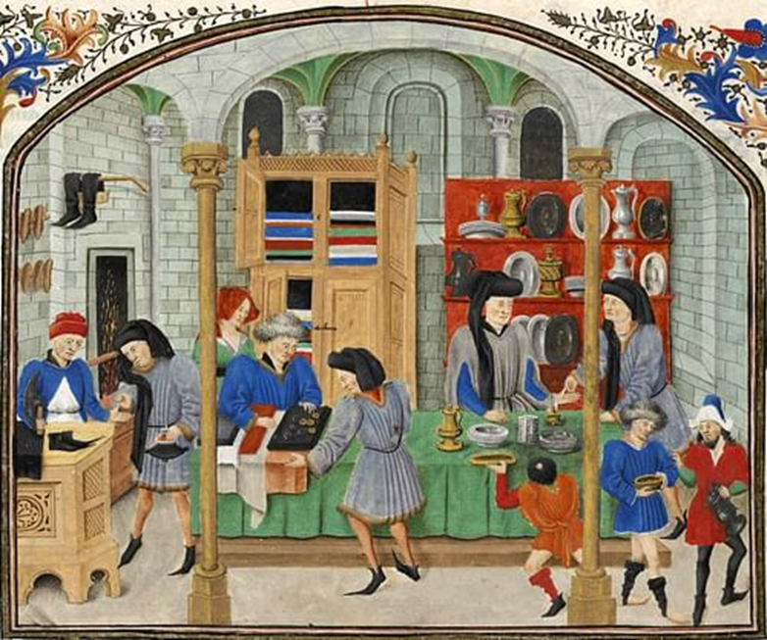
Merchants
But some people want to see God with their own eyes as they see a cow, and they want to love God as they love a cow. You love a cow for her milk and her cheese and your own profit. That is what all those men do who love God for outward wealth or inward consolation- and they do not truly love God, they love their own profit. I truly assert that anything you put in the forefront of your mind, if it is not God in Himself, is - however good it may be - a hindrance to your gaining the highest truth. – Sermon 16b
Who were the people who were buying and selling in the temple, and who are they still? Now listen to me closely! I shall preach now without exception only about good people. Nevertheless, I shall at this time show who the merchants were then and still are today—those who were buying and selling then, and are still doing so, the ones our Lord whipped and drove out of the temple. And he is still doing so to those who, despite everything, continue to buy and sell in the temple. He will not allow a single one of them to be there. Behold how all those people are merchants who shun great sins and would like to be good and do good deeds in God’s honor, such as fasts, vigils, prayers, and similar good deeds of all kinds. They do these things so that our Lord may give them something, or so that God may do something dear to them. All these people are merchants. This is more or less to be understood since they wish to give one thing in return for another. In this way they wish to bargain with our Lord. – Sermon 1

Slide 13
Eigenschaft obscures the True Self
Charlotte Radler says detachment for Eckhart is about removing layer after layer of the false and illusory self to uncover true identity: "a detached human being removes layer after layer of its constructed pseudo-self until it uncovers the true core of itself, that is, the transcendent nothingness.”

Slide 14
God and Soul are inherently ONE
God’s ground is my ground and my ground is God’s ground. – Sermon 5b
What is life? God’s being is my life. If my life is God’s being, then God’s existence must be my existence and God’s is-ness is my is-ness, neither less nor more. – Sermon 6
Between [the human person] and God, however, there is not only no distinction, there is no multiplicity either. There is nothing but one. – Sermon 40
We are always already ONE with God

Slide 15
God’s ground is my ground, and my ground is God’s ground. Here I live from what is my own, as God lives from what is his own. Whoever has looked for an instant into this ground, to such a man a thousand marks of red, minted gold are no more than a counterfeit penny. It is out of this inner ground that you should perform all your works without asking, “Why?” I say truly: So long as you perform your works for the sake of the kingdom of heaven, or for God’s sake, or for the sake of your eternal blessedness, and you work them from without, you are going completely astray. You may well be tolerated, but it is not the best. Because truly, when people think that they are acquiring more of God in inwardness, in devotion, in sweetness and in various approaches than they do by the fireside or in the stable, you are acting just as if you took God and muffled his head up in a cloak and pushed him under a bench. Whoever is seeking God by ways is finding ways and losing God, who in ways is hidden. But whoever seeks for God without ways will find him as he is in himself, and that man will live with the Son, and he is life itself. If anyone went on for a thousand years asking life: “Why are you living?” life, if it could answer, would only say: “I live so that I may live.” That is because life lives out of its own ground and springs from its own source, and so it lives without asking why it is itself living. If anyone asked a truthful man who works out of his ground: “Why are you performing your works?” and if he were to give a straight answer, he would only say, “I work so that I may work.” Where the creature stops, there God begins to be. Now God wants no more from you than that you should in creaturely fashion go out of yourself, and let God be God in you. – Sermon 5b

Slide 16
Teasing out Sermon 5b
Ground
Live without a why
Working from without
Finding ways but losing God
Discovering God in the ordinary
Happens by letting go and letting be
Gelassenheit means discovering the true self – one with God

