Slide 1
Pure Release
meister Eckhart’s Way to Unity with God

Slide 2
Released Knowing

Slide 3
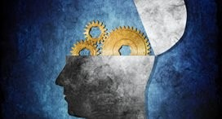
Releasement: Getting More Accurate
What is Gelassenheit?
It is NOT a physical or penitential action
Rather, Gelassenheit is
the deconditioning of knowing
the unleashing of consciousness
Simple interior silence
presence in the now

Slide 4
I am as certain as that I am a man, that nothing is so close to me as God. God is closer to me than I am to myself: my being depends on God's being near me and present to me. So He is also in a stone or a log of wood, only they do not know it. If the wood knew God and realized how close He is to it as the highest angel does, it would be as blessed as the highest angel. And so man is more blessed than a stone or a piece of wood because he is aware of God and knows how close God is to him. And I am the more blessed, the more I realize this, and I am the less blessed, the less I know this. I am not blessed because God is in me and is near me and because I possess Him, but because I am aware of how close He is to me, and that I know God. – Sermon 68

Slide 5
Intellect
From the 1st Parisian Question: “So God, who is the creator is not creatable, is an intellect and understanding; He is not a being or existence.”
The Second of the Parisian Questions: “The intellect as an intellect is none of the things it knows” and “if the intellect, therefore, insofar as it is an intellect, is nothing, it follows that neither is understanding some existence.”
So, Eckhart names God as intellect before being
Intellect is not smarts but Awareness or Consciousness
But beyond self-consciousness
God is Ultimate Consciousness but what is Consciousness? Nothing.

Slide 6
Intellect is Nothing
This divine ‘No-thing-ness,’ or indistinction, is also present in us, that is, in the human mind as true imago dei. Humanity, according to Eckhart, is what it is through intellect, ‘because intellect is open to infinity. – Bernard McGinn
the intellect is not just no material thing and therefore capable of receiving the forms of all material things, as Thomas taught, but it is no-thing at all in its complete identity with God. – Bernard McGinn

Slide 8
Intellect, as such, is nothing

Slide 9
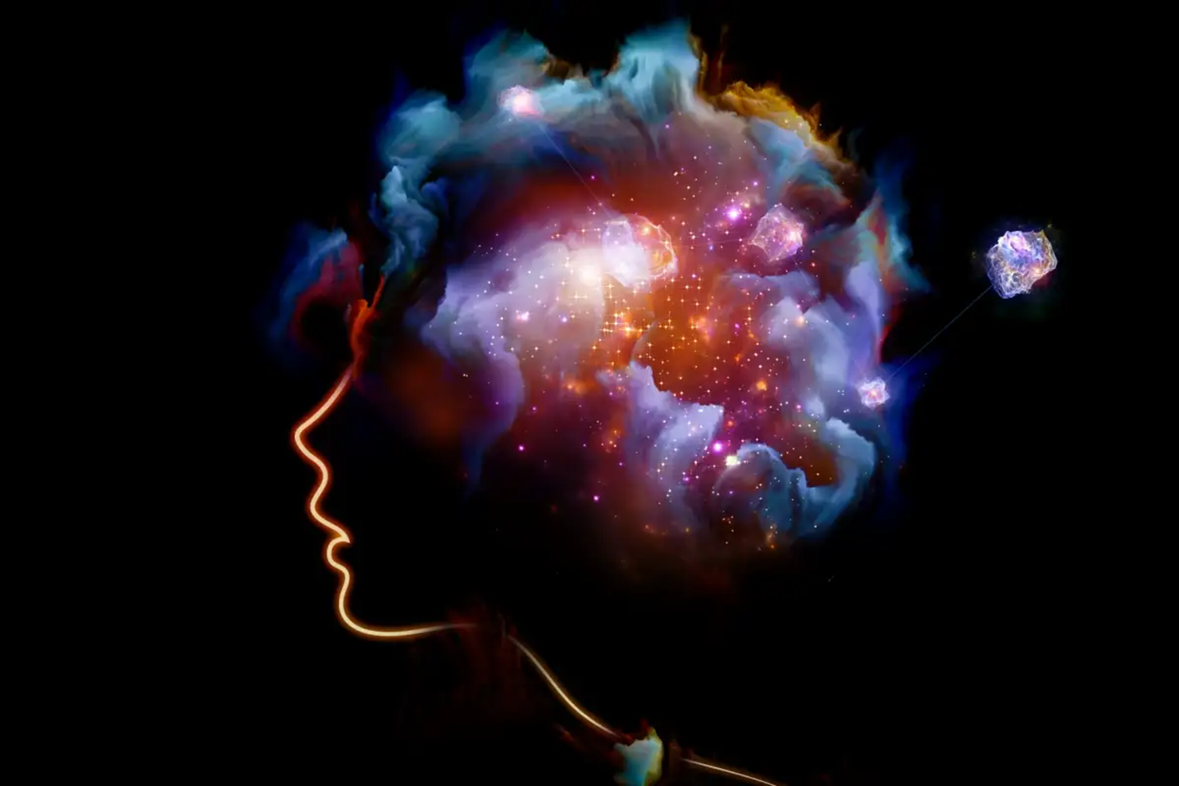
Transcendence happens within
The intellect is our consciousness, our inwardness
To transcend all things, leaving them behind and turning to God, is something that happens within
It is an event of knowing
Inwardness is a depth, a ground without ground, an abyss

Slide 10
Gelassenheit: An Event of Knowing
We release ourselves into God and are released from attachments, from the self, by pure knowing or unknowing
Letting go, letting be, detachment, turning to God and keeping God in mind are all the same event of Pure Knowingness or Unknowingness or Transcendent Knowingness
For, the divine intellect is our intellect
And pure knowing is not an effortful, striving work but an effortless “act” of clear awareness and translucent attentiveness
A free mind is one which is untroubled and unfettered by anything, which has not bound its best part to any particular manner of being or devotion and which does not seek its own interest in anything but is always immersed in God’s most precious will, having gone out of what is its own. – Talk 2

Slide 11
But how? By Knowing nothing but God
When we are concerned with God, we are little concerned with things outside. – Sermon 71
The “God-knowing person” – Sermon 10
“keeping God alone in mind” – Sermon 62
I once thought on my way, that a man should be so wholly detached in his intention that he had nobody and nothing in view but the Godhead in itself—neither salvation nor this or that, but just God as God, and the Godhead in itself. For whatever else you concern yourself with is an admixture to the Godhead. And so shed all admixtures to the Godhead, and seize it naked as it is in itself. – Sermon 77
I declare truly that, as long as anything is reflected in your mind which is not the eternal Word, or which looks away from the eternal Word, then, good as it may be, it is not the right thing. For he alone is a good man who, having set at naught all created things, stands facing straight, with no side glances toward the eternal Word – Sermon 16b

Slide 12
Talk 6
“the right state of mind”
“If you truly have God and only God, nothing will disturb you. Why? Because you are totally focused upon God and only God. Therefore, everything is nothing but God to you. You reveal God in every action, in every situation. All your activities point to God…If your intention is God and only God then God does what you do and nothing can disturb you, neither society nor surroundings. And no person can disturb you, for you consider nothing, look for nothing, relish nothing other than God…”
Detachment “demands hard work and great dedication and a clear perception of our inner life and an alert, true, thoughtful and authentic knowledge of what the mind is turned towards in the midst of people and things.”
“hard work and great dedication”
“a clear perception of our inner life”
“an alert, true, thoughtful and authentic knowledge of what the mind is turned towards in the midst of people and things”
“we must learn to maintain an inner solitude regardless of where we are or who we are with.”

Slide 13
Sermon 68 on the blessedness of KNOWING
The soul that is to know God must be so established and fixed in God that nothing can make an impression on it—neither joy nor suffering nor love nor sorrow nor anything else could take the soul from its own course. Heaven in all places is equally distant from the earth. Similarly the soul should be equally distant from all earthly matters so that it is not nearer to one than another. The sky is equally far from any point on the earth’s surface. So too should the soul be equally far from all earthly things.
Nothing so much hinders the soul’s understanding of God as time and space…if the soul is to recognize God, it must do so beyond space and time. For God is neither this nor that in the way of the manifold things of earth, since God is one…If the soul would know God, it must know God beyond time and space.
Insofar as it knows God, the soul knows itself and in God knows all things from which the soul has separated itself. In the degree to which the soul has separated itself from itself and from all things, to the same degree the soul knows itself fully.
No one should think that it is a burdensome thing to come to this point, even though it sounds serious and significant. It is true enough that it is somewhat difficult at the beginning when one is separating oneself from himself and from all things. But when one has made some spiritual progress, he discovers that there has never been a lighter, more delightful, or more joyful life.

Slide 14
The “right state of mind” is the “state of nothing”
From Sermon 103:
“Enter a state of pure nothingness”
“The very best thing you can do is to remain still as long as possible”
“Remain still and do not waiver from this emptiness”
“We should train ourselves to keep God always present in our mind”

Slide 15
The Birth of Pure Knowing
Sermon 76: we enjoy one knowing with God by being the Son
The knowing of God is the knowing of every released person is the Son is the abyss of the Godhead
For Meister Eckhart, God as unlimited knowingness is nothingness
Divine knowing is unrestricted knowing itself, unconditioned and beyond all mental processes
Jesus the Word communicates this Divine Knowledge, which is not a set of facts but the Pure Transcendent Knowing of the God beyond God
The more we let go of particular knowledge, thoughts and feelings and experiences, the more Divine Knowledge awakens in us and as us—detaching from time, space, individuality
Waking up: coming alive from within, fullness brimming over into conscious experience – wholehearted attentiveness, expansive wonderment

Slide 16
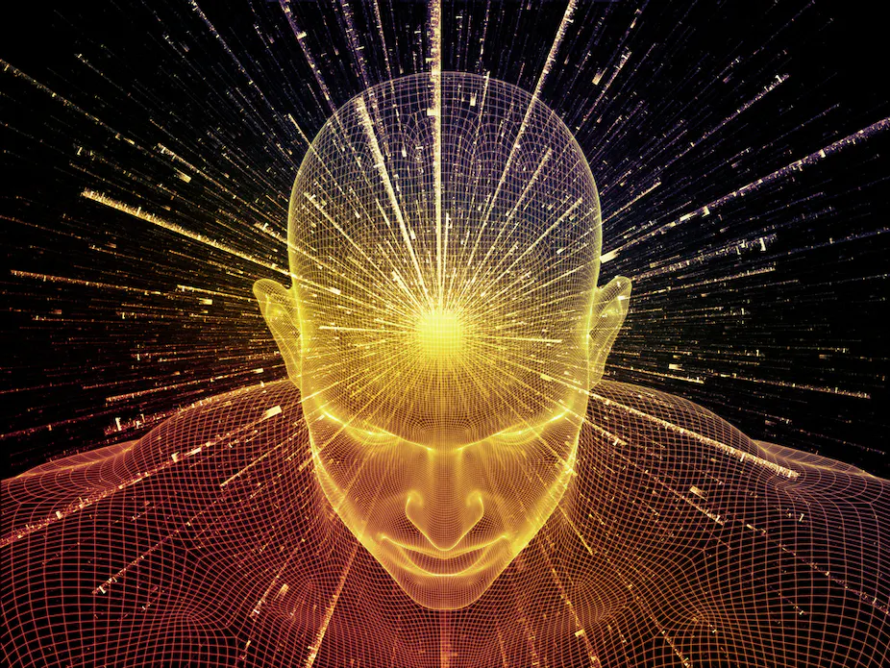

Slide 17
Prayer Ending Sermon 68
Never has a person longed after anything so intensely as God longs to bring a person to the point of knowing him. God is always ready but we are very unready. God is near to us but we are very far from him. God is within us but we are outside. God is at home in us but we are abroad…God help us that we all follow him so that he can bring us to the point where we truly know him. Amen.

