Slide 1
Pure Release
meister Eckhart’s Way to Unity with God

Slide 2
Released From Rigidity

Slide 3
A Mystic According to Eckhart
His Goal: mystical atheists – not churchy, religious, pious people but mystics in the marketplace who are simply AWARE, liberated in the Nothing, nothing in the Nothing – atheists in the sense that these mystics do not believe in a god separate from them but the NIHT of the Godhead – they believe in nothing, the godless nothing or, rather, they live in and as the nothing
When God is born, do the laundry
Once God is realized, clean the kitchen
After the birth, go to work, take care of the kids, live and love
One is released into daily life
Released from all determinations, all law and morality
What about Church?
Major Issue Today: Loneliness

Slide 4
Eckhart and the Church
“in such a frame of mind [Gelassenheit] if you stepped on a stone it would be a more godly act than to receive the body of the Lord while more concerned with your own affairs or in a less detached frame of mind.” - Talk 5
In 1294, Eckhart preached his Easter sermon in Paris, and on Christmas Eve, Boniface VIII came to power in Rome. He had pressured his predecessor, Celestine V, the “angelic” pope, to abdicate. – Kurt Flasch
The pope does not feature as a religious figure in Eckhart’s works. Dante was more political in his thinking: he raged against the politics of the papacy, but recognized its spiritual function. Eckhart ignored the pope completely, as both spiritual sovereign and politician. – Kurt Flasch
Eckhart ignores ecclesiastical power, serves the people of God, attempts to detach anyone in his spiritual sphere of influence from neurotic and fanatical adherence to religious things
Without any explicit formulation, he recognizes the major problem with religion: ego

Slide 5
Wherever and whenever religion gets rigid, Eckhart advises releasement
The anarchy of divine nothingness
let the divine be absolute not law, morality, ritual
Let go of control through over-explaining, rules, hierarchy
Let others be themselves without forcing them to conform to some mental ideal
Let God be God, not the divine sanction for hierarchies of all kinds
why do we pray, why do we fast, why do we all perform our devotions and good works, why are we baptized, why did God, the All-Highest, take on our flesh?...in order that God may be born in the soul and the soul be born in God. That is why the whole of Scripture was written and why God created the whole world. – Sermon 38
All religion is directed to awakening, to the birth
You should traverse and transcend all the virtues, drawing virtue solely from its source in that ground where it is one with the divine nature. And, inasmuch as you are more united to the divine nature than are the angels, they must get it from you. That we may be One, may God help us. Amen. – Sermon 16b
So whenever religion does not lead to awakening, Eckhart advises letting it go

Slide 6
Secular Atheism Not The Answer Either
Reiner Schurmann in Wandering Joy writes,
“Atheistic despair is the counterpart of the increasing urge for security in our civilization. But Eckhart frustrates the scaffolding of guarantees, theistic as well as atheistic, when he declares: whoever looks for assurance will find nothing; only he who is not attached to any sache, any firm support, will find the ursache where all guarantees vanish…
…The premise of atheistic thought is the search for assurance. It declares that man can be sure only of himself. Eckhart's premise, on the other hand, is the refusal of all assurance, which leads him to exalt not man, but the unknowable ground of God.”

Slide 7
Relief from Loneliness
When I come into the core, the soil, the stream, and the source of the Godhead, no one asks me where I’m coming from or where I’ve been. No one has missed me in the place where God unbecomes.

Slide 8
Transcendent Connection
I am not missed nor do I miss anyone because we are all there in the Ground beyond distinction; we are all distinct yet indistinct in the Godhead
Whatever I know of creatures in God, nothing enters in but God alone; for in God there is nothing but God. When I know all creatures in God, I know nothing. He saw God, where all creatures are nothing…The nothing was God…all creatures exist in God as nothing. – Sermon 71
Everyone is the divine nothing; my reality is your reality and this reality is the nothing
KNOWING, pure and clear and transcendent, washes away all loneliness
When the mind flows back into its nature, when it rises above its personal being, above even God, it penetrates into erstekeit, the source of identity which in its ground it had never left, and it recovers a joy that it had never lost. The First, the Godhead, is source as well as ocean: always in back of and always ahead of detachment. - Schurmann

Slide 9
Divine Knowing ends our inescapable inner loneliness
Once Divine Knowledge is realized, we are known from within, and more, we are the Divine Knowledge that is all things, beyond all things, wholly transcendent, unconditioned, all-inclusive, eternal, and divine nothingness.
To know God in God as God – the divine knowing transform us to see with the eyes of divine mercy, knowing all things as one, as The One
“God is neither this nor that...There in the Principle all grass-blades, wood, and stone, all things are identical.”
God knows me as my very self – one with all, knows me limitlessly, and is still Mysteriously Other

Slide 10
Eckhart’s Metaphorical Play

Slide 11
True detachment is nothing other than this: the spirit stands as immovable in all the assaults of joy or sorrow, honor, disgrace or shame, as a mountain of lead stands immovable against a small wind.

Slide 12
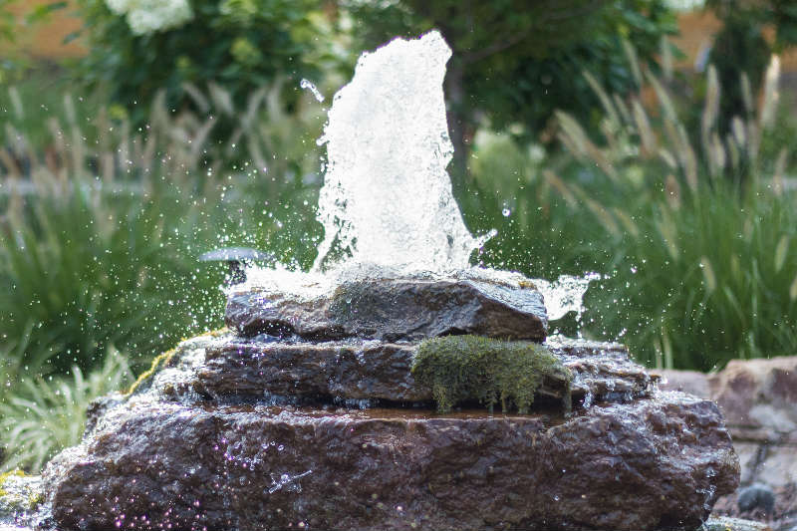
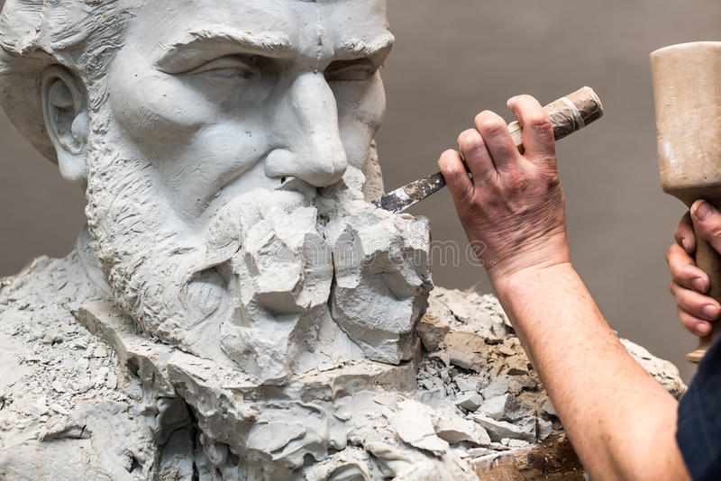
The sun is always shining, but when there is a cloud or mist between us and the sun, we do not see its brightness, nor when the eyes are diseased or blind can they see its light.
When the artist makes a statue of wood or stone, he does not put the image in the wood; he chips away the wood that hides the form. He gives the wood nothing, he takes it away: carves it out where too thick, pares off overlay, and then there appears what was hidden. This is the treasure hid in a field, of which our Lord tells in the Gospel.
God’s Son, God’s image, is in the ground of the soul like a living spring. If earth is thrown on it, earthly desire that is, it smothers it, covers it over, and it vanishes from our ken. But in itself it remains alive, and on removing the soil that was thrown on from without, we see it again.

Slide 13
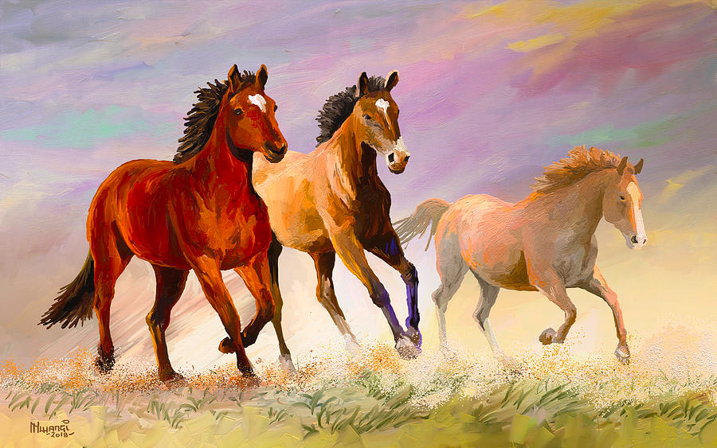
The eye in which I see God is the same eye in which God sees me. My eye and God’s eye are one eye and one seeing, one knowing and one loving. – Sermon 12
It is just as enjoyable for him as when someone lets a horse run loose on a meadow that is completely level and smooth. Such is the horse’s nature that it pours itself out with all its might in jumping about the meadow. This it would find delightful; such is its nature. So, too, does God find delight and satisfaction where he finds sameness. – Sermon 12

Slide 14
The Inner Wine Cellar
A person who is not at home with inward things does not know what God is. It is just like a man who has wine in his cellar and, having neither drunk nor even tried it, does not know that it is good. This is exactly the situation of people who live in ignorance: They do not know what God is and they think and fancy they are really living. Such knowledge is not from God. One must have a pure and translucent knowledge of divine truth. – Sermon 10

Slide 15
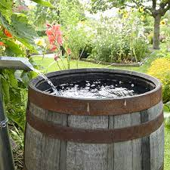
Water in a Barrel
The soul is one with God and not united. Here is a simile: if we fill a tub with water, the water in the tub is united but not one with it, for where there is water there is no wood, and where there is wood there is no water. Now take the wood and throw it in the middle of the water, still the wood is only united and not one (with the water). It is different with the soul: she becomes one with God and not united, for where God is, there the soul is, and where the soul is, there God is.

Slide 16
When the soul comes to this, she loses her name and God draws her into himself, so that she becomes nothing in herself, as the sun draws the dawn into itself, so that it is annihilated.

Slide 17
Summarizing Gelassenheit

Slide 18
Sermon 28
You must give up yourself, altogether give up self, and then you have really given up.
It is blindness and folly, so long as you care a jot for what you have given up. But if you have given up self, then you have really given up.
The man who has resigned himself is so purified that the world will have none of him.
The just man serves neither God nor creatures, for he is free, and the closer he is to justice, the closer he is to freedom, and the more he is freedom itself.
“as long as you have any regard for yourself in any way or for anything, then you will not know what God is. As my mouth knows what colour is and my eye what taste is: that is how little you will know what God is.” Sermon 28
Alternate translation:
But as long as you mind yourself or any thing at all, you know no more of God than my mouth knows of color or my eye of taste
Losing all individuality, all self, to realize the thrilling joy of indistinct nothingness

Slide 19
PRACTICING
Where are you rigid? What are you rigid about?
When do you tighten up? About what do you need to relax?
REALIZE THE NOTHING BY RELEASING
Releasing as an event of knowing in which one does not pay attention to self – with its thinking, content, forms, images – but abides in unknowing silence, which is to pay attention to the God beyond God
Remain in the state of non-thinking nothingness as much as possible – doing only nothing in meditation and abiding – in a relaxed manner – in this state all through your day.
Return to the state of Gelassenheit by a word, your breath, a simple glance

Slide 20
Gelassenheit
Detachment means releasing God, self, distinction
Releasing this and that - identities, attachments, distinctions, time-place
The right state of mind that is the state of pure nothingness
Wanting nothing, knowing nothing, having nothing – describes the state of nothing
“When he saw God, he viewed all things as nothing.” – Paying attention to God means not paying attention to things – paying attention to Nothing
Gelassenheit involves seeing when your mind becomes occupied, seeing what occupies it, and sinking back into the Nothing
The released person allows all their layers of illusory self to fall away in the searing light of inner and divine knowing until oneness with God emerges
Sinking into the Indistinct Nothingness that is always already one’s eternal reality
Stripped of all mentality, individuality annihilated, Knowing is the indistinct nothing
To realize my being is the Nothing requires no ascetic regime but only a gentle dropping – effortless nothingness

